Slide 1
Name: Swapnil Ghosh
Roll: 001911001067
Dept: IT
Group: A2
TASK 7

Slide 2


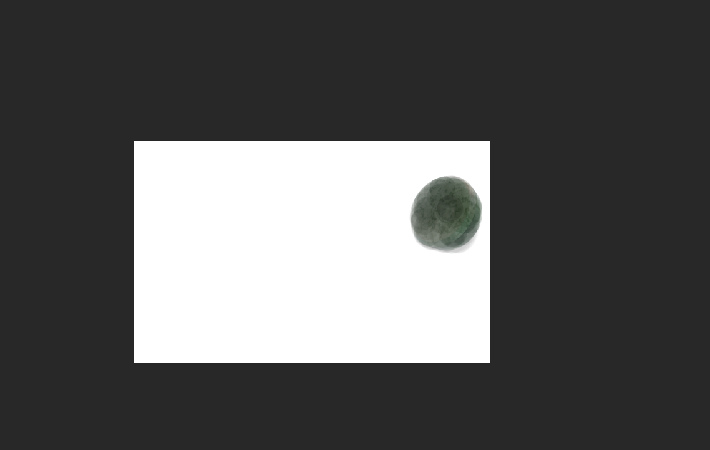


Step-1) Opened the file ICONS.PSD in Photoshop.
Step-2) Use Polygonal Lasso for the selection of white star.
Step-3) Used the Polygonal Lasso for the golden square and subtract the hole from selection.
Step-5) Used Pen tool to select the blue curve.
Step-5) Masked Out The circle from the Image.
Step-6) Used Magic Wand to select text icons.

Slide 3

Step-7) Switched off the Background layer.

